Slide 1


Team 54: Remote Thermal Viewing within High Voltage
Bi-Weekly Update 1 Blake Bagley, Julia Garcia, Erica Mathew
Sponser: Powell Industries
TA: Zian Wang

Slide 2
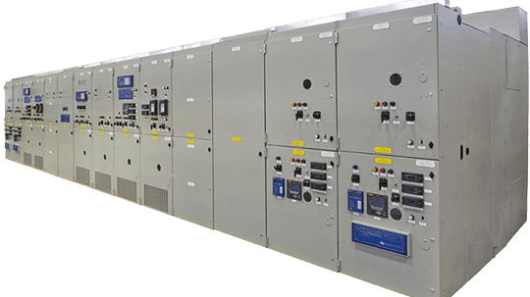

Project description
Problem statement: “As industry demand grows, space inside medium voltage switchgear has become increasingly limited. Manufacturers are required to fit more devices and wires within the same limited space. Additionally, manufacturers are now being asked to include a remote viewing system within the switchgear to monitor a physical ground switch. This ground switch is physically blocked, by wires, from the view of the operator.”
Notes:
Erica: Our project sponsor is powell industries which is a “Powell Industries designs and manufactures equipment like switchgear, circuit breakers, and power management systems that help safely control and distribute electrical power in multiple different industries
Switchgears are Switchgears are devices that control and protect electrical circuits by turning power on or off and preventing damage during electrical faults.
Powell industries designs/maufactures
explain switchgears
explain project

Slide 3
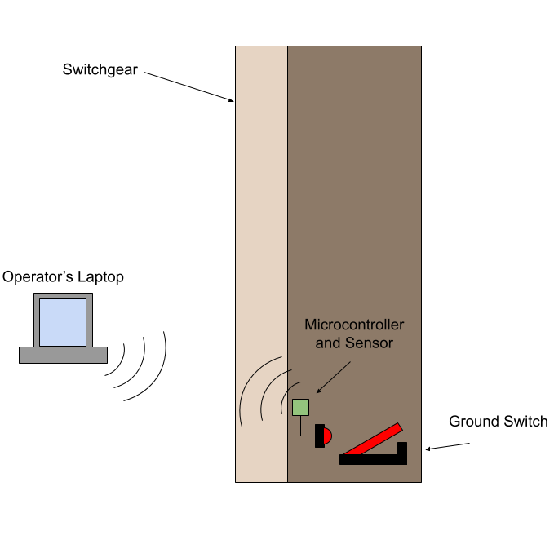
Project Solution Description
Solution proposal: Our solution to this problem is to create a thermal remote viewing system that an operator can connect to through Wi-Fi, allowing for operators to confirm the grounding switch is either open or closed through video and automation. This will make switchgear operators jobs safer and more convenient.
Notes:
Blake

Slide 4
System Overview
Power Supply
Thermal Sensor
Battery
Website
Converters
Microcontroller
Julia, Blake, Erica
Notes:
Julia: Design the power supply and overall hardware of the system.
Blake: Microcontroller coding and ML
Erica: Creating Web Application for users to interact with

Slide 5
Major Project Changes for 404
PCB design has been updated
components added, nothing removed
Possibly could use Bluetooth connection rather than WiFi

Slide 6
Project Timeline
Update #1: Designed and ordered new PCB + started integrating Microcontroller/Website
Update #3: Have PCB working and have microcontroller programmed + switch state communication
Update #5:
Practice Demo + Completing Final Report + Preparing for Showcase
Update #2: Have PCB soldered and tested + Website/Microcontroller connection
Update #4: All Integration between subsystems complete

Slide 7
Subsystem 1: PCB
Accomplishments since 403 <9> hrs of effort | Ongoing progress/problems and plans until the next presentation
Completed in 403
Entire PCB design
4 individual buck converter designs
Simulated all designs on WEBench
Designed schematic
created necessary footprints
Routed the board
Soldered the board
The two buck converters ICs failed during demo, so its not currently working.
404 Accomplishments
Board was updated
added push buttons for ESP32 programming
added pull-up resistor for the Boot function of the ESP32
created necessary footprints
Once the parts and boards come in, I’ll begin soldering, testing the converters as I go.
Boards will take at least a week to come in.
Once the converters are working, I’ll add the ESP32 to the board and the camera socket.

Slide 8
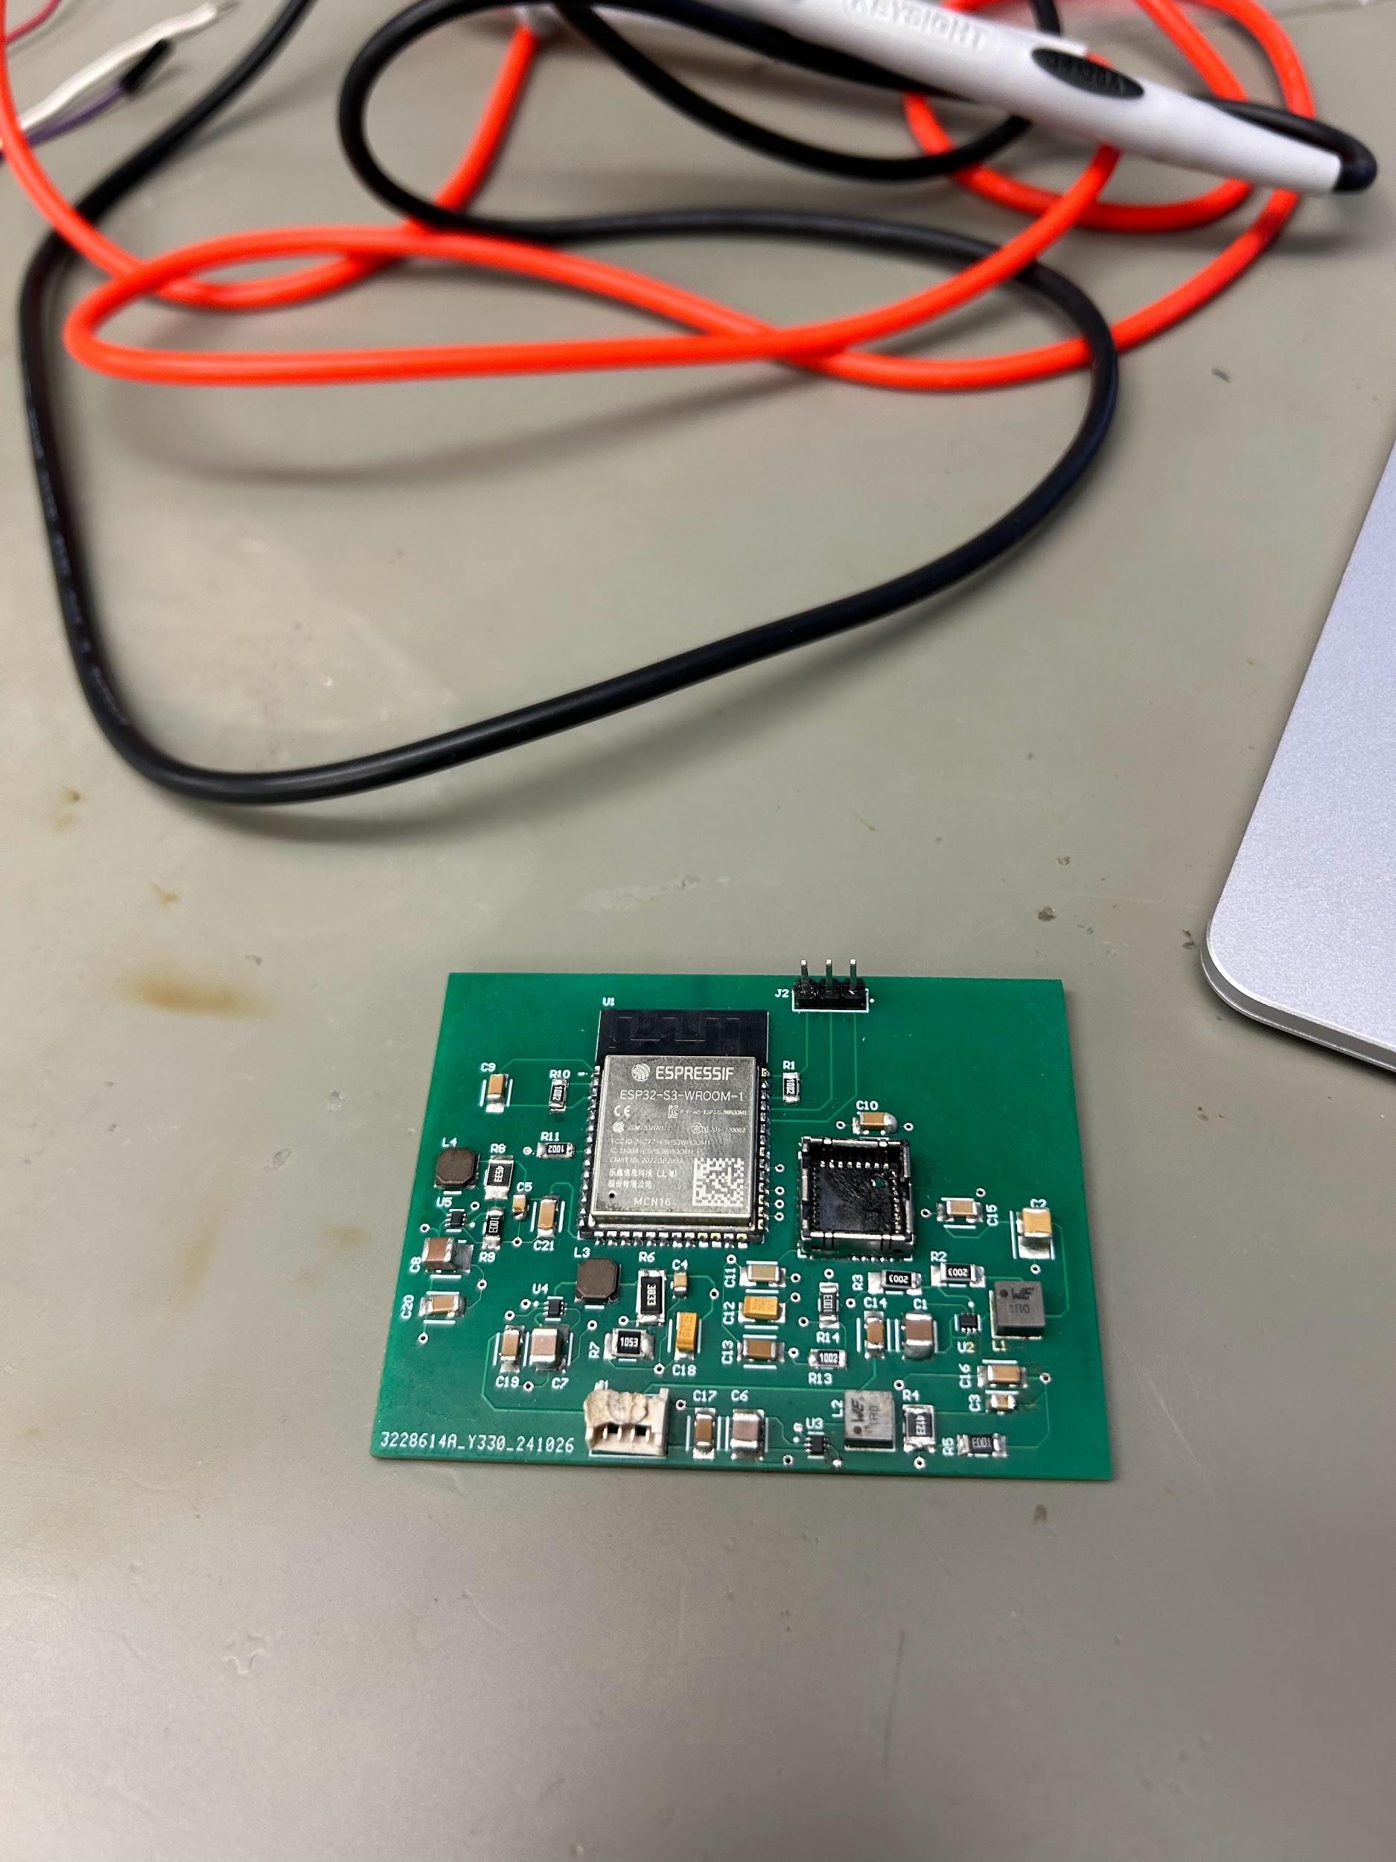
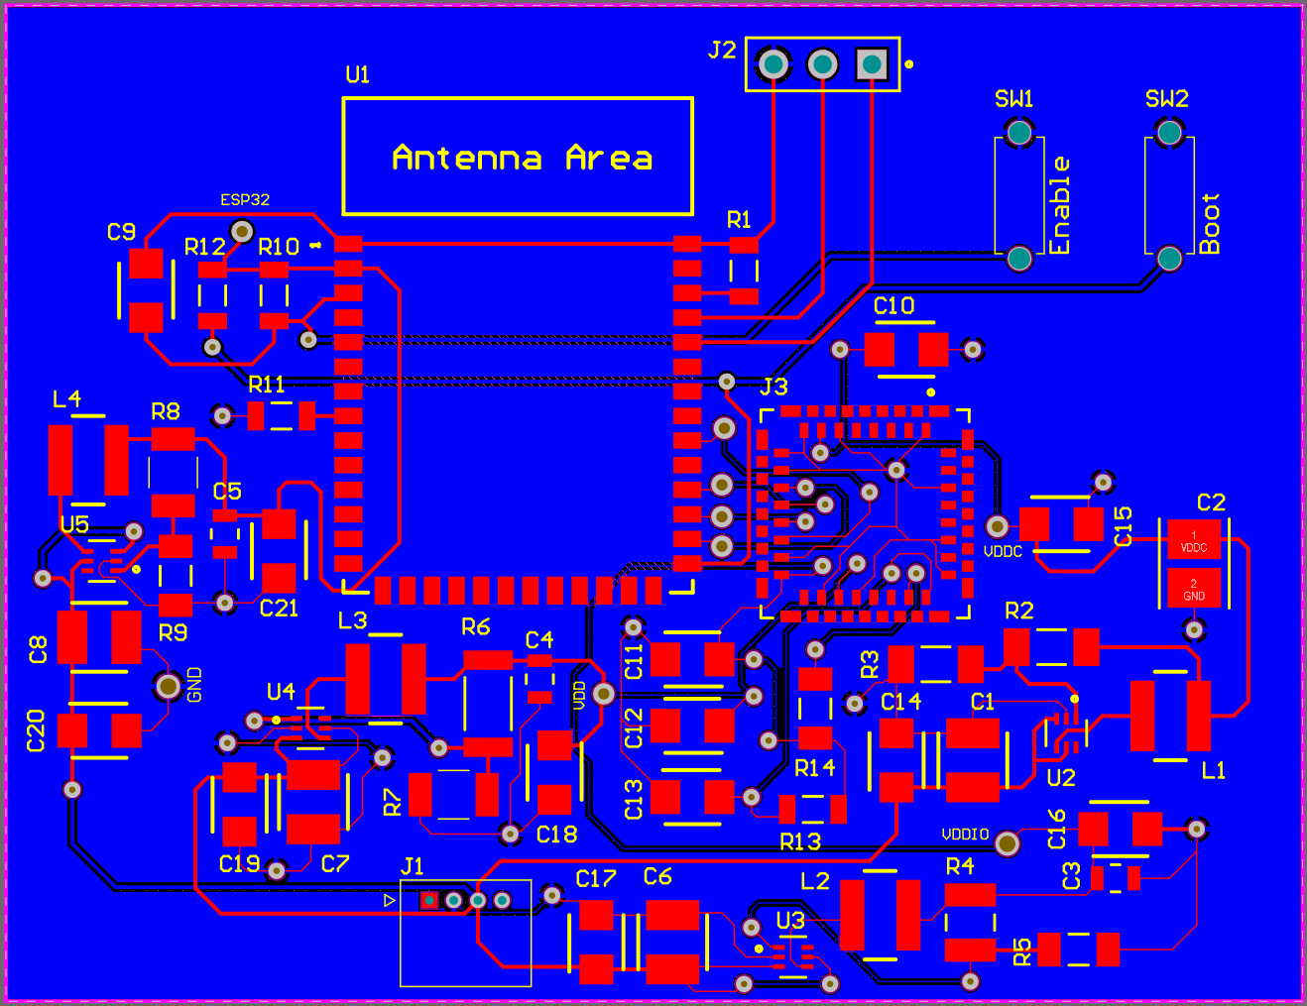
Subsystem 1: PCB
The buck converter design works, however there was component failure that resulted in failure of two converters on the board.
Both failed converters provide power to the camera, so camera to ESP32 communication remains untested.
Power to VDDIO pin and power to VDD pin converters produce the incorrect values.
Push buttons need to be added to allow us to program the ESP32.
One additional resistor (R12) was added to the board to ensure the ESP32 functions.
Multiple vias were made larger so they could be used as test points.

Slide 9
Subsystem 2: Microcontroller
Accomplishments since 403 <10> hrs of effort | Ongoing progress/problems and plans until the next presentation
Completed in 403
Microcontroller was coded to
Interpret data coming from the image sensor via SPI communication
Connect to a personal laptop through WiFi
Automatically determine if the switch is open or closed based on the image data received
404 Accomplishments
Minor changes to allow for integration to the PCB
Changes to allow for multiple photos to be read and a more efficient way to connect to WiFi
More research into the API’s for the communication between the microcontroller and the website
Try to integrate the website with the microcontroller as much as we can before the next update. I want to try and get the microcontroller to at least see a connection to the website.
As soon as the new PCB comes in, test to see if the microcontroller code can successfully run on it.

Slide 10
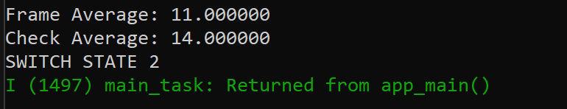
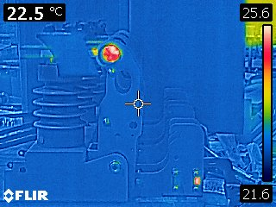
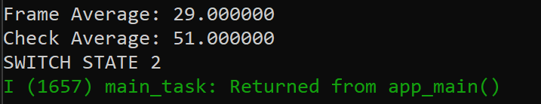
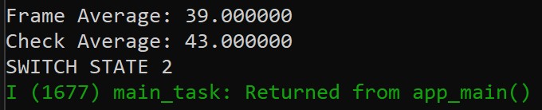
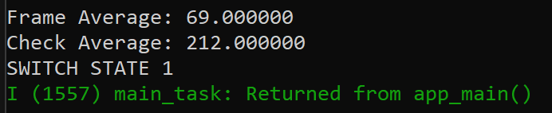
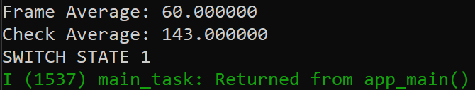
Subsystem 2: Microcontroller
Nothing in frame
Heat in bottom half
Heat in right half
Heat in top half
Heat in left half

Slide 11
Subsystem 3: Website
Accomplishments since 403 <12> hrs of effort | Ongoing progress/problems and plans until the next presentation
Completed in 403
Website was completed and contained:
Login/ Registration pages with firebase authentication
Overview Page displaying multiple video streams
Map Builder that allowed user to virtually match their switchgear setup
A websocket server that sent images to the website at regular intervals to mimic a video stream
404 Accomplishments
Cleaned up code + fixed existing errors
Researched best ways to integrate website to the microcontroller
Modified websocket server to read incoming images instead of pre-stored images
Outlined timeline for integration
Work with Blake to send a test HTTP post request from the microcontroller to the servers IP address
Modifying websocket server to process incoming live images from microcontroller using HTTP post endpoint

Slide 12

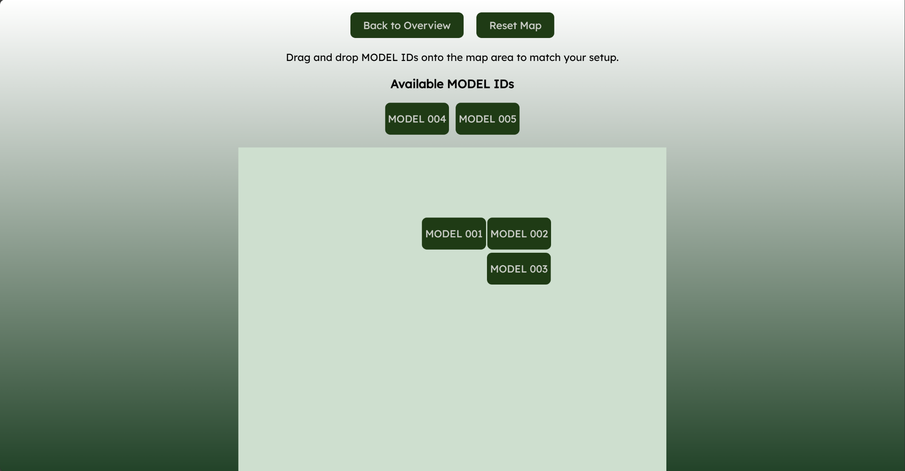
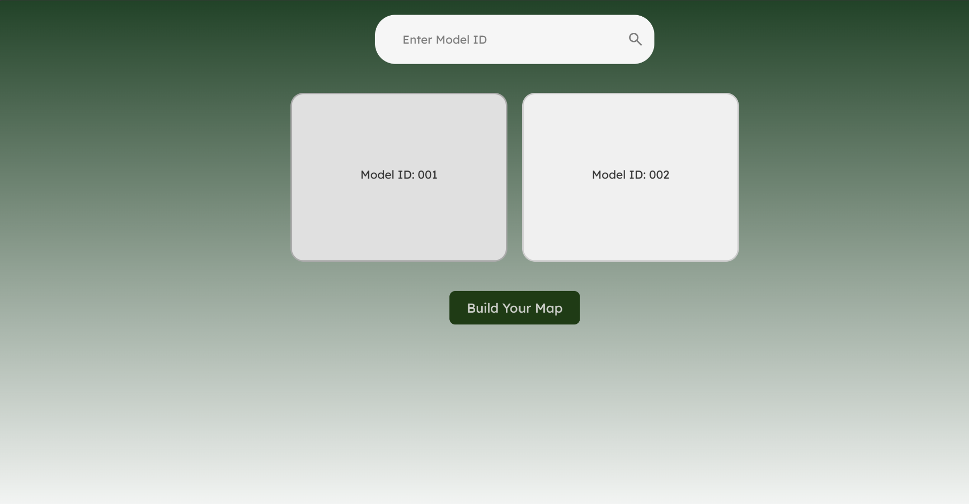
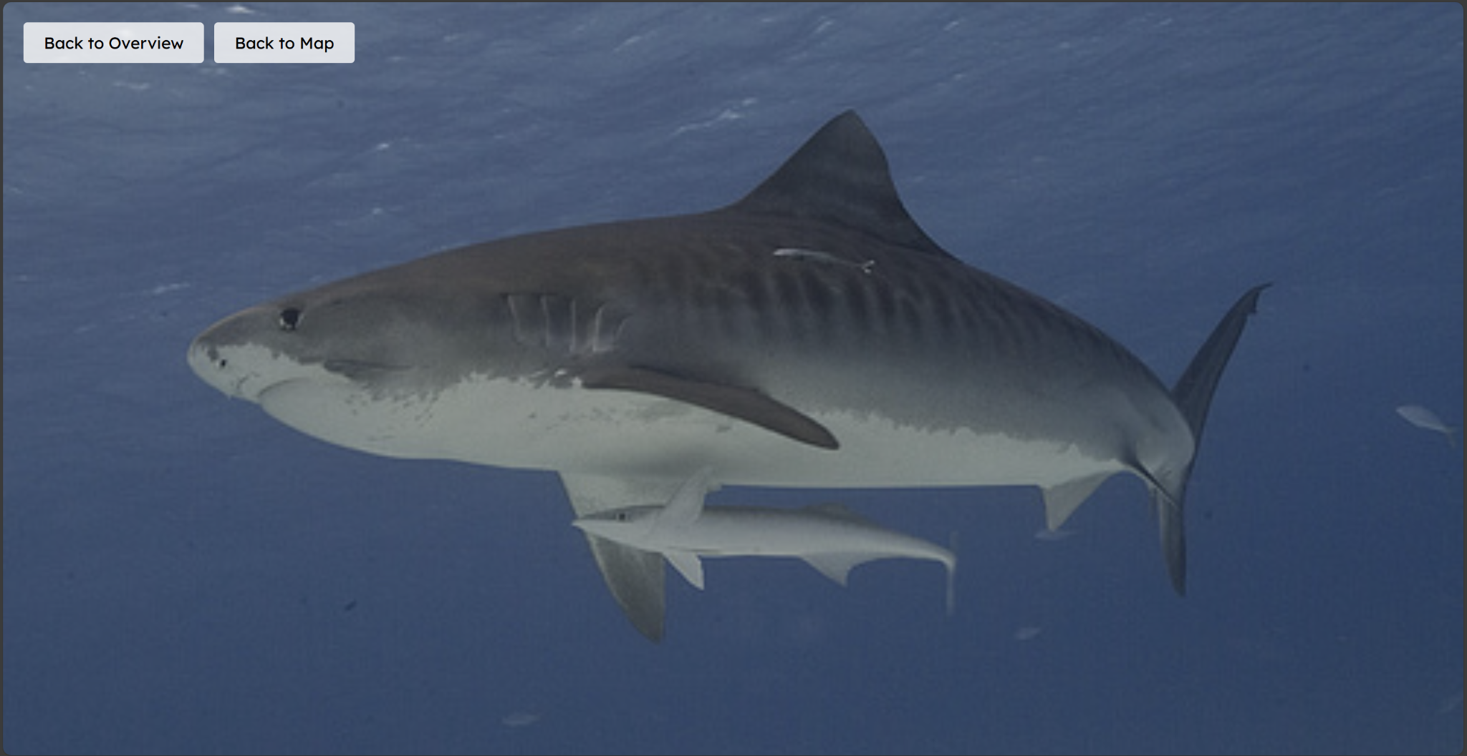
Subsystem 3: Website
Login/Registration Page
Map Builder Page
Overview Page
Video Page

Slide 13
Parts Ordering Status
All parts were ordered on 1/17, the order was processed 1/21 by the business office.
The updated board has been ordered, set of 5.
Boards should arrive 7-10 days after being ordered. (1/28 - 1/31)
Components to be soldered onto the board, all ordered from Digikey and Mouser.
Passive components (resistors, capacitors, etc.)
Buck Converter ICs
Camera sockets
Push buttons
Connectors
Digikey has processed the order, delivery date is currently unavailable.

Slide 14
Execution plan
 | 1/20/25 | 1/27/25 | 2/3/25 | 2/10/25 | 2/17/25 | 2/24/25 | 3/3/25 | 3/10/25 | 3/17/25 | 3/24/25 | 3/31/25 | 4/7/25 | 4/14/25 | 4/21/25 | 4/28/25
PCB Updated
Updated PCB ordered
Parts Ordered
Researched Integration
Microcontroller Code Modified
Website Code Modified
Status Update #1
New boards soldered
Verify Server can receive data from microcontroller
Buck converters tested
Website and Microcontroller Connection |  |  |  |  |  |  |  |  | Not Started
UHMW Polyethylene sheet ordered
Status Update #2 |  |  |  |  |  |  |  |  | In Progress
MCU and Website communication tested |  |  |  |  |  |  |  |  | Completed
PCB and Microcontroller Integration |  |  |  |  |  |  |  |  | Behind
UHMW Polyethylene Box made
MCU and Website Communicate Switch State
Dielectrics Testing
Status Update #3
Website and Microcontroller Fully Integrated
Full System Integration
Status Update #4
Troubleshoot any issues
Practice Demo
Status Update #5
Final Presentation
Final Demonstration
Final Report

Slide 15
Thank you for listening!

